Slide 1
Analysis of Boroughs of Toronto for Residential Preference

Slide 2

Introduction
Capital city of the Canadian province of Ontario
Most populous city in Canada and the fourth most populous city in North America
One of the most multicultural and cosmopolitan cities in the world
The city’s immigrant population has been growing steadily over the past several decades
Reasons for immigrants’ attraction
Employment
Culture
Diversity
Access to services
Purpose of the study – To analyze the city based on above reasons.
Toronto

Slide 3
Data Description and Methodology
Data source: https://en.wikipedia.org/wiki/List_of_postal_codes_of_Canada:_M
Tools used for the analysis
Folium
Geocoder
Matplotlib
Forsquare API

Slide 4
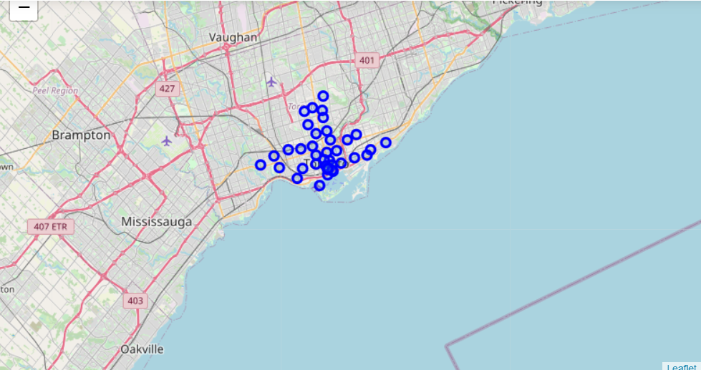
Data Analysis
Map of Toronto with 103 neighborhoods

Slide 5
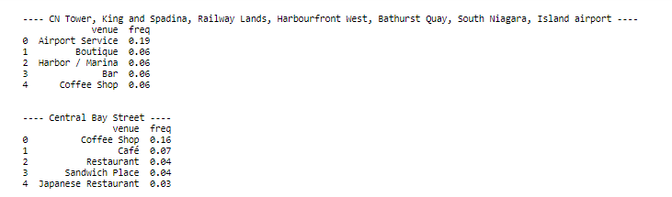
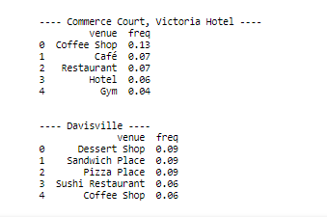
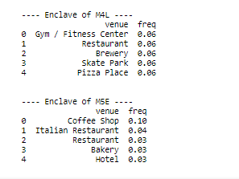
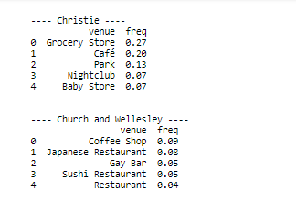
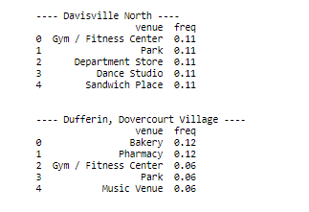
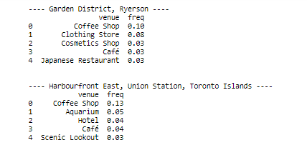
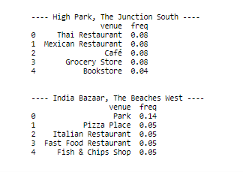
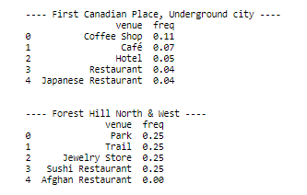
Most common venues for each borough
*Full list is available in the notebook

Slide 6
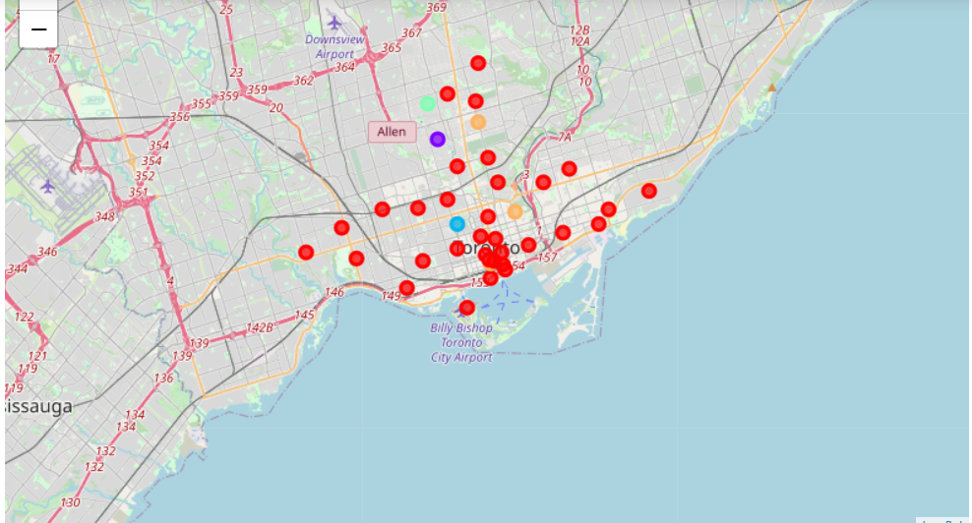
Neighborhood clustering based on most common venues

Slide 7
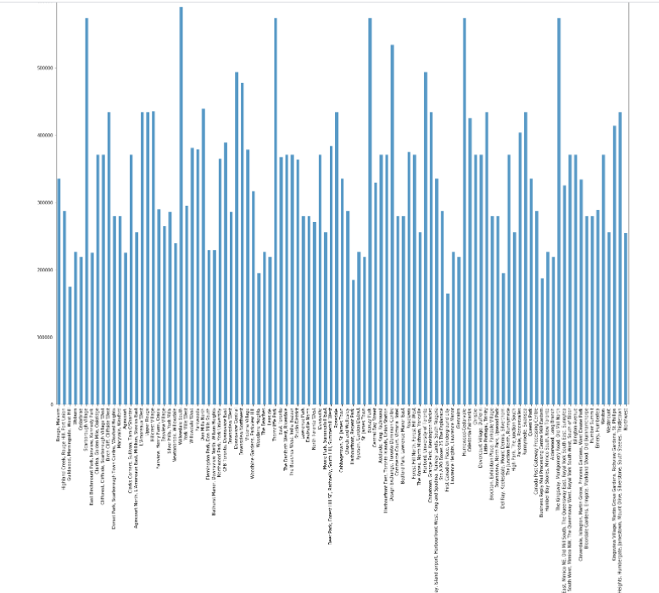
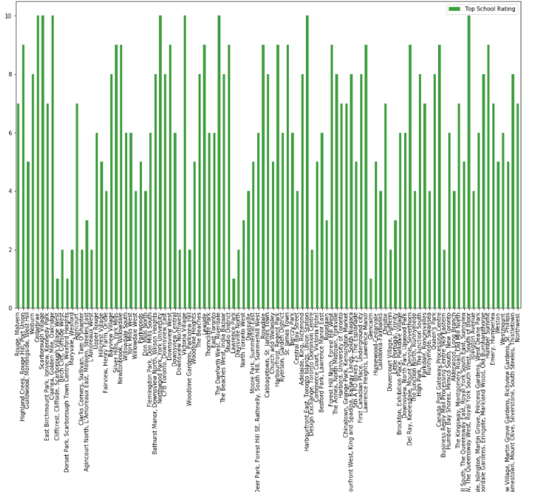
Analysis based on Housing prices and School ratings
Housing Prices
School Ratings

Slide 8
Conclusion
City boroughs were analyzed for following parameters
Socio economic parameters
Neighborhood conditions
Facilities available in the neighbourhood
How the area matches to your way of living
Housing Prices
School ratings

